Slide 1
OLAP Queries
A common operation is to aggregate a measure over one or more dimensions.
  Find total sales.
  Find total sales for each city, or for each state.
  Find top five products ranked by total sales.
Roll-up: Aggregating at different levels of a dimension hierarchy.
  E.g., Given total sales by city, we can roll-up to get sales by state.
Principles of Database Systems, Xu Lizhen

Slide 2
OLAP Queries
Drill-down: The inverse of roll-up.
  E.g., Given total sales by state, can drill-down to get total sales by city.
  E.g., Can also drill-down on different dimension to get total sales by product for each state.
Pivoting: Aggregation on selected dimensions.
Slicing and Dicing: Equality and range selections on one or more dimensions.
Principles of Database Systems, Xu Lizhen

Slide 3
The CUBE Operator
Generalizing the previous example, if there are k dimensions, we have 2^k possible SQL GROUP BY queries that can be generated through pivoting on a subset of dimensions.
CUBE PID, SID, DID BY SUM Sales
  Equivalent to rolling up Sales on all eight subsets of the set {pid, locid, timeid}; each roll-up corresponds to an SQL query of the form:
Lots of work on optimizing
the CUBE operator!
SELECT SUM (S.sales)
FROM Sales S
GROUP BY grouping-list
Principles of Database Systems, Xu Lizhen

Slide 4
Examples of Queries on Cube
SELECT PID, SID, Quarter, SUM (SaledMoney) AS TotalSales
FROM Sales S, Dates D
WHERE S.DID=D.DID
CUBE BY PID, SID, Quarter;
--- Generate a data cube including 2³ views.
CUBE(TV,No1,Q1)
  Query TV’s total sales of store No1 in first quarter.
CUBE(ALL,No1,Q1)
  Query total sales of store No1 in first quarter.
CUBE(ALL,ALL,Q1)
  Query total sales in first quarter.
CUBE(ALL,ALL,ALL)
  Query total sales in whole year.
CUBE(TV,No1,Q1) + CUBE(VCD,No1,Q1)
CUBE(ALL,ALL,Q1) / CUBE(ALL,ALL,ALL) * 100%
Principles of Database Systems, Xu Lizhen

Slide 5
Examples of Roll-up / Drill-down
SELECT PID, SID, DID, SUM (SaledMoney) AS TotalSales
FROM Sales
GROUP BY PID, SID, DID ROLLUP;
--- Generate four views : PSD, PS, P, and ALL
SELECT PID, SID, DID, SUM (SaledMoney) AS TotalSales
FROM Sales S, Dates D
WHERE S.DID=D.DID AND Year BETWEEN 1997 AND 1998
CUBE BY PID, SID, DID
ROLLUP Day, Month, Quarter, Year;
  CUBE(TV, No1, 1998)
  CUBE(TV, No1, 1998.Q4)
  CUBE(TV, No1, 1998.12)
Principles of Database Systems, Xu Lizhen

Slide 6
Design Issues
TIMES
timeid
date
week
month
quarter
year
holiday_flag
pid
timeid
locid
(Fact table)
sales
SALES
PRODUCTS
LOCATIONS
pid
pname
category
price
locid
city
state
country
Fact table in BCNF; dimension tables un-normalized.
  Dimension tables are small; updates/inserts/deletes are rare. So, anomalies less important than query performance.
This kind of schema is very common in OLAP applications, and is called a star schema; computing the join of all these relations is called a star join.
Principles of Database Systems, Xu Lizhen

Slide 7
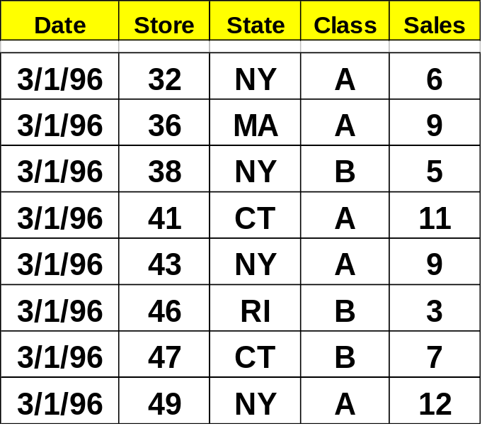
Bitmap index – index itself is data
Bitmap Index for Sales
8bit 4bit 2bit 1bit
0 1 1 0
1 0 0 1
0 1 0 1
1 0 1 1
1 0 0 1
0 0 1 1
0 1 1 1
1 1 0 0
Bitmap Index for State
AK AR CA CO CT MA NY RI … …
0 0 0 0 0 0 1 0
0 0 0 0 0 1 0 0
0 0 0 0 0 0 1 0
0 0 0 0 1 0 0 0
0 0 0 0 0 0 1 0
0 0 0 0 0 0 0 1
0 0 0 0 1 0 0 0
0 0 0 0 0 0 1 0
for Class
A B C
1 0 0
1 0 0
0 1 0
1 0 0
1 0 0
0 1 0
0 1 0
1 0 0
Total sales = ? (4*8+4*4+4*2+6*1=62)
How many class A store in NY ? (3)
Sales of class A store in NY = ? (2*8+2*4+1*2+1*1=27)
How many stores in CT ? (2)
Join operation (query product list of class A store in NY)
Principles of Database Systems, Xu Lizhen

